Slide 1
Purpose and algorithm
JMS habitat models

Slide 2
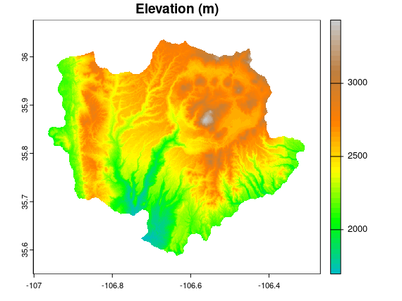
Purpose
Use the data from the observed scenario to output a map of probability of occurrence for JMS for each simulation year. Quantify landscape composition and structure based on the probability of occurrence maps. Create visualizations in geographic space and in data space.
Presence/absence locations and associated predictor variables (firebgc habitat variables) will be extracted from inside buffered JMS locations (presence data-black circles) and from outside the buffers, at random points (absence data-white circles).
Algorithm: part I
Use a set of random points from within point buffers that represent known areas of JMS presence.
Extract values for fire bgc habitat variables of interest [list here] by replicate and simulation year.
Repeat the sampling/extraction of values at a set of random points. What will be the constraints on defining these locations? Physical environment? Distance apart? Distance from presence buffer?

Slide 3
Algorithm: part II
Fit gbm using presence/absence data and habitat variables from fire bgc, one model per year (use data for all replicates for a given year). Are there other predictors we might add?
Assess model fit for each model year and output relative influence graphs and stats.
link to gbm3: https://github.com/gbm-developers/gbm3
Generate spatial predictions for the Jemez landscape.
Use the spatial preditions (maps) to Identify potential methods for quantifying and visualizing spatial patterns for each year and across simulation years.
Presence/absence locations and associated predictor variables (firebgc habitat variables) will be extracted from inside buffered JMS locations (presence data-black circles) and from outside the buffers, at random points (absence data-white circles).

